Slide 1
A Visual Analytics Framework for Adversarial Text Generation
By,
Brandon Laughlin, Ontario Tech University; Christopher Collins, Ontario Tech University; Karthik Sankaranarayanan, Ontario Tech University; Khalil El-Khatib, Ontario Tech University
Reference to this paper:
Brandon Laughlin, Christopher Collins, Karthik Sankaranarayanan, & Khalil El-Khatib. (2019). A Visual Analytics Framework for Adversarial Text Generation.
Link to the paper:
https://arxiv.org/pdf/1909.11202.pdf

Slide 2
What is the problem ?
There are many algorithms to find adversarial text
But finding an appropriate one is difficult
Algorithms may yield poor output changing the semantics or syntax
Lack of interaction between the user and the system

Slide 3
What is the research goal?
To allowing users to interfere with the system
To allow users to to make corrections to the adversarial texts
To pair the algorithm to the Visual Analytic loop.
For mitigating adversarial threats

Slide 4
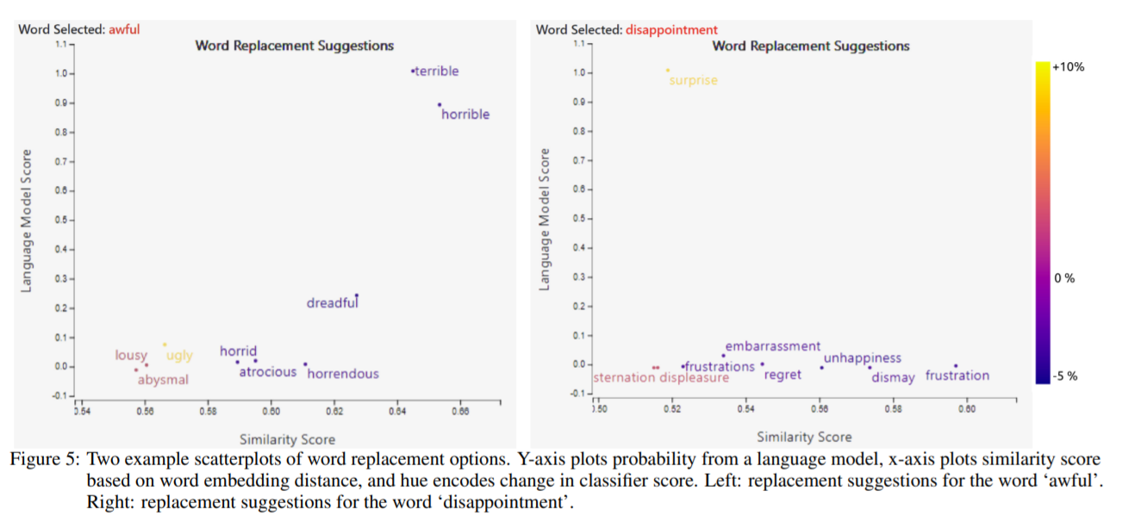
Use cases
The main objective is to convert a negative review to a positive review.
The main method used is the swapping technique.

Slide 5
A Deeper dive into the problem
Adversarial Machine Learning as a threat.
Using the outside data from the trained distribution for malicious operations.
Texts can’t be modified as modifying image pixels.
These problems can be avoided using automated attack algorithms with human intervention
Adversarial text can be used for spamming, phishing and online harassment.

Slide 6
Methods being applied
A framework for combining the existing attack algorithm with a visual analytic dashboard.
Producing a set possible generations(outcomes).
The input is processed by the attack algorithm and generate an output.
Likewise the algorithm runs multiple times and produces various outputs for the provided input
Making the dashboard interactive for optimizing the outcomes.

Slide 7
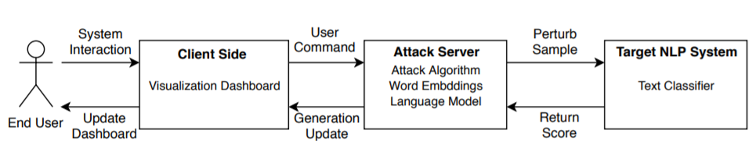
Working of the proposed method

Slide 8
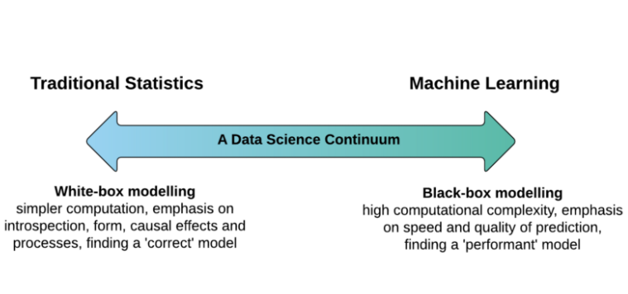
Types of Adversarial Machine Learning
There are two main types of adversarial attacks
White box -linear regression and decision trees
Black box - neural networks, gradient boosting models or complicated ensembles often provide great accuracy.

Slide 9
Visualizing the data
Global scope explanation would provide details of how the system works as a whole.
Local scope explanation provide context specific information.
The framework suggested in this paper uses local scope explanation.
Euclidean and cosine distance between the vectors are used to visualize the word embeddings

Slide 10
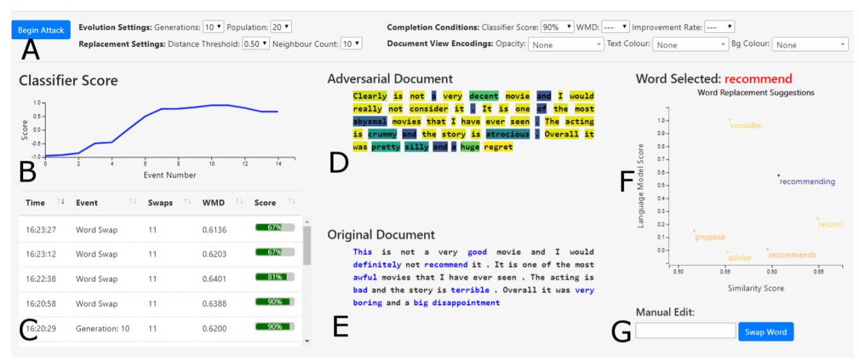
The Dashboard

Slide 11
Framework description
The frontend is the web dashboard
Backend is the attack server.
The analytics are done on the server producing results on the browser.
The framework is made flexible by allowing users to switch between word embeddings and the model.

Slide 12
Attack selection
When generating adversaries there are several factors to be considered to maintain the qu. They are,
Content preserving
Semantic preserving
Syntax preserving
Suspicion
Legibility
Readability

Slide 13
Completion conditions
Completion conditions are used to define the point at which the system stops attacking.
There certain conditions to be considered,
Classifier score
Word movers distance
Duration
Performance acceleration

Slide 14
Interaction methods
Since our framework is designed for blackbox evasion attacks, it involves repeated sending of perturbed inputs.
Hence it is time consuming.
So, a combination both human and the algorithm can overcome this drawback.
There are three methods of interaction,
Automated
Guided
Direct

Slide 15
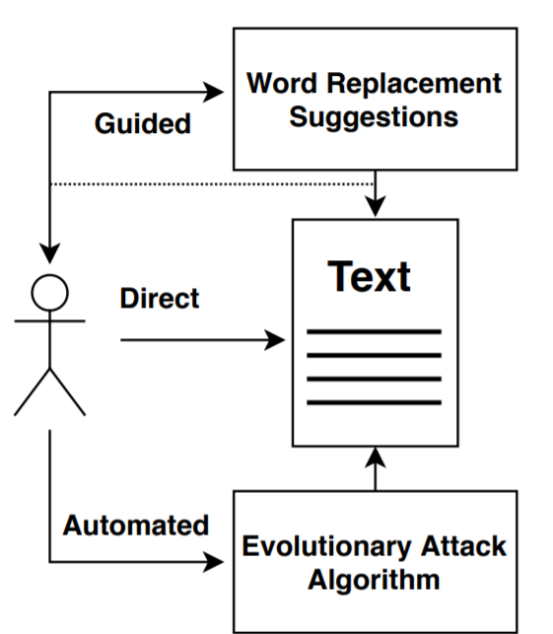
The interaction process
The automated evolution is ran first.
Then guided method is run for providing suggestion.
There is no specific order and it can be ran in any order.
To prevent the algorithm from simply switching back the words the user has changed, any words edited by the user are automatically locked.
This lock prevents the algorithm from making any further changes to these words. .

Slide 16
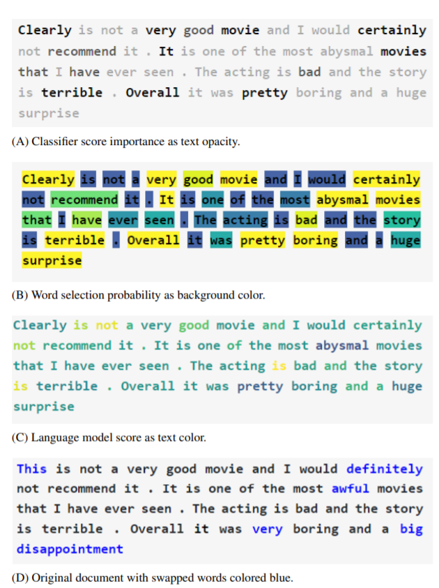
Document View
The original and the adversarial text is displayed.
The dashboard is updated to show the best output.
The words that are changed are encoded based on,
Classifier score influence
Word selection probability
Model score.

Slide 17
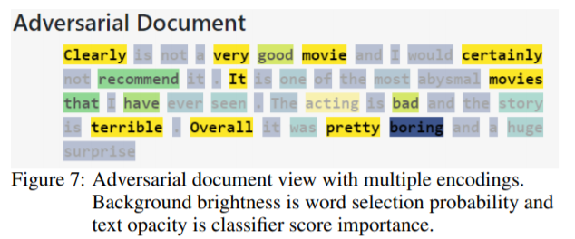
Adversarial document

Slide 18
Robustness testing
The user test three different classifiers by running the attack algorithm for each one.
The algorithm runs 10 generations for each record.
The dataset used for this process is IMDB dataset with 50,000 reviews
Each reviews are scored from 1 to 10 by human.

Slide 19
Classifiers used
Three classifiers used are VADER, LSTM and ULMFiT.
VADER is a sentiment analysis classifier
LSTM is an average Deep Learning classifier.
ULMFiT is a transfer learning method used for training the model.

Slide 20
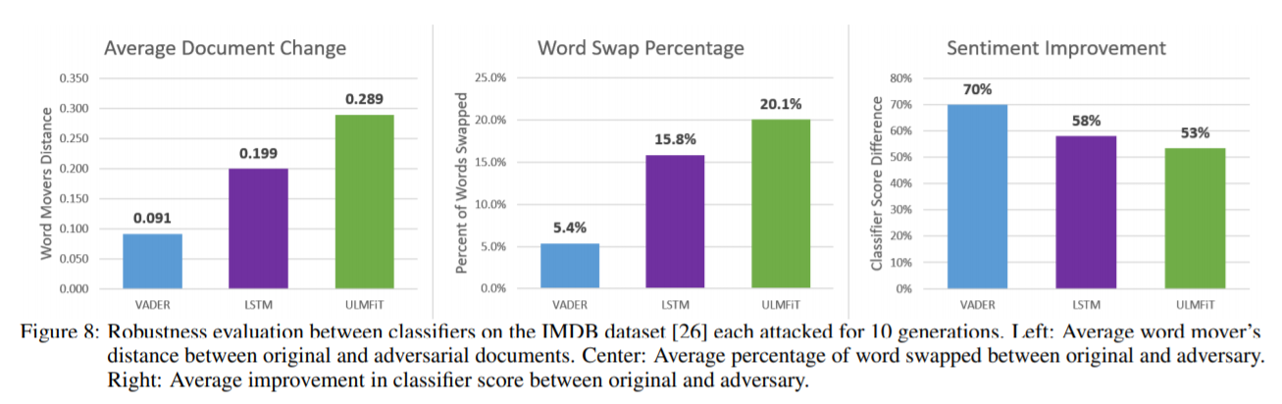
Results
VADER scores - 59%
LSTM scores - 84%
ULMFiT - 95.4%

Slide 21
Limitations
The framework assumes that there are unlimited access to the NLP classifier.
The encodings are done by querying the classifier.
This causes the algorithm to be computationally expensive as the number of words in the input document increase.

Slide 22
Future work
An extension to the views could include a filter to remove options such as different parts of speech, word tenses, or proper nouns.
To use of contextual word embeddings that could provide more appropriate nearest neighbour
An extension to the current evolutionary algorithm can include a user steerable stage of speculative execution
The framework can be extended to test various defense strategies to help strengthen the models against adversarial examples.

Slide 23
Conclusion
Thus this framework extends existing evolutionary attack strategies to be used with a visual analytics dashboard.
The framework is a black box and model-agnostic system
Once a set of adversaries has been built the user can make corrections manually or via suggestions by the system.
The suggestions are made by visually encoding the documents and providing replacement options in the scatterplot.

Slide 24
Thank You!

